Slide 1
2021/2022 FAN Summer Research Scholarship
Name: Andre Webber
Project: DC Housing Community Outreach Project
Notes:
NAME:
Hello, my name is Andre. I am an Electrical and Electronics Engineering student at VUW.
PROJECT
Over the summer I have been working on a DC housing outreach project aimed at high school students.

Slide 2
Project Details
4 scale model houses
Simulation of household power consumption over a 24-hour period.
Current Sampling
Notes:
4 scale model houses
The idea of this project is to produce 4 scale model houses, each containing “appliances” represented by LEDs and load resistors to dissipate power at a 1:100 scale to the appliances they represent.
Simulation of household power consumption over a 24-hour period.
Appliances must be individually switched to allow for a simulation of household power consumption over a 24-hour period.
Current Sampling
Current will be sampled at each simulation tick so a power vs time graph can be generated

Slide 3
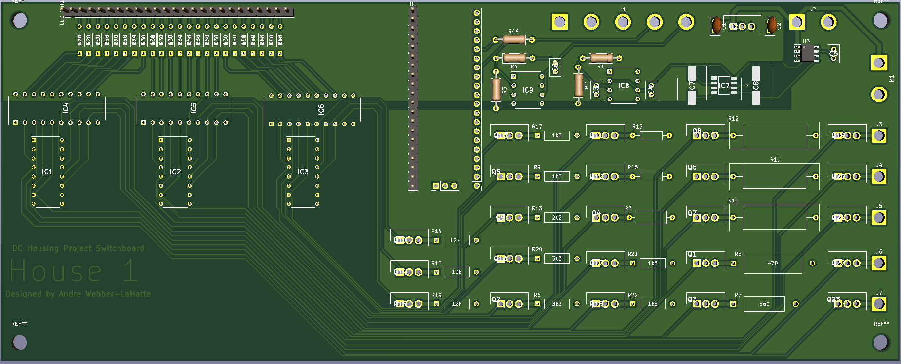
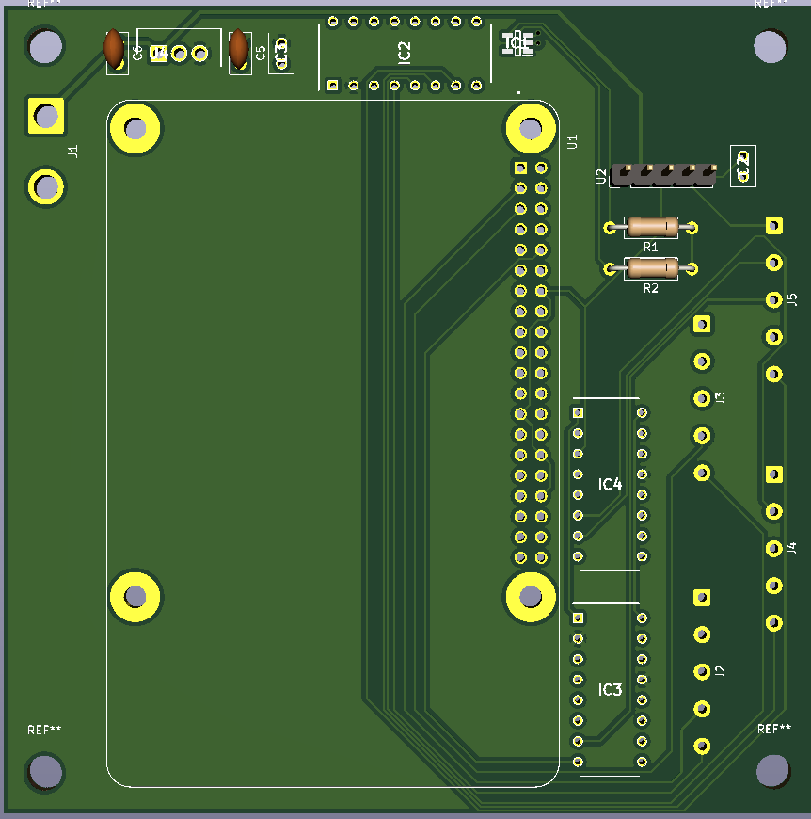
What I have done
Switch Board
Control Board
Notes:
So far, I have completed designs, and ordered components for 2 PCBs:
Switch Board
Using a Raspberry Pi Pico, this board controls the switching of each appliance, with an output that allows the LEDs within the house models to be connected. This board also houses the load resistors and current detection circuit for each house.
Control Board
Using a Raspberry Pi, this board can communicate and sample current individually from 4 houses

Slide 4
Design Approach
Communication
Switching
Current Detection
Notes:
My design approach focussed on 3 main aspects.
Communication.
Communication.
Switching.
Switching.
Current Detection.
Current detection.

Slide 5
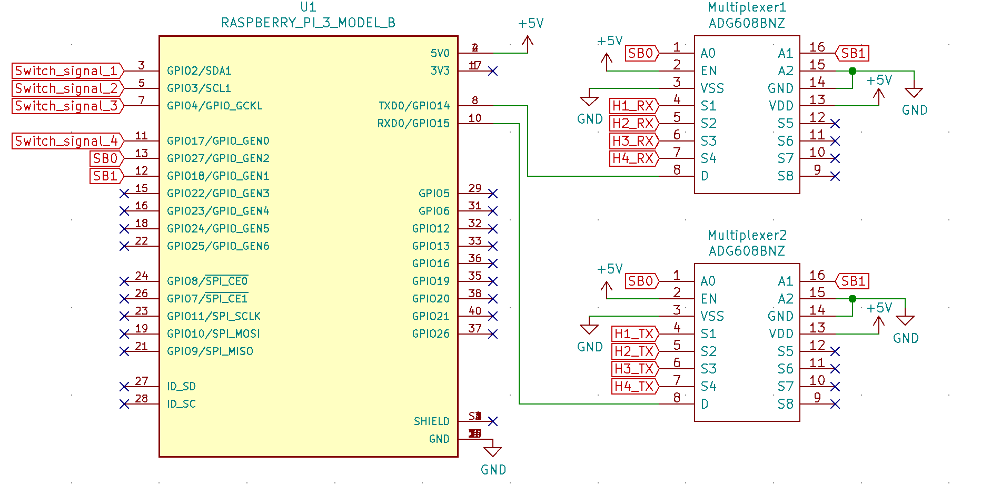
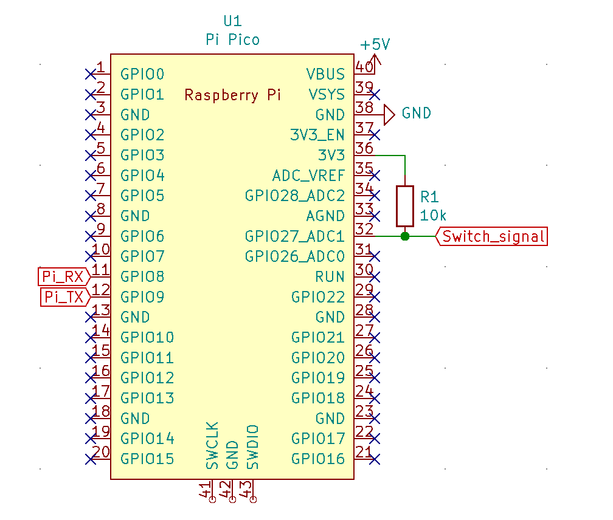
Communication
Control end
House end
Notes:
Control end:
Using 2 4:1 multiplexers (or in this case, 2 8:1) the Raspberry Pi can communicate individually with each house over UART by selecting which house it is talking/listening to. The Pi also used a single line per house which will be pulled low to indicate a switch needs to be made.
House end:
This is a quick schematic showing the Pico end of communication topology. Showing the pull up resistor on the switch signal line.

Slide 6
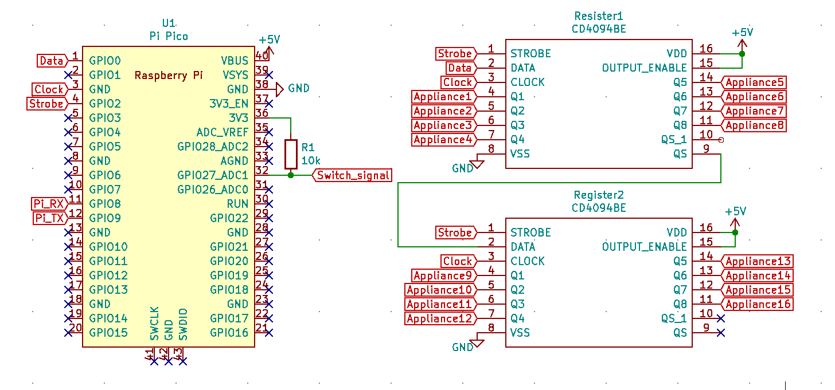
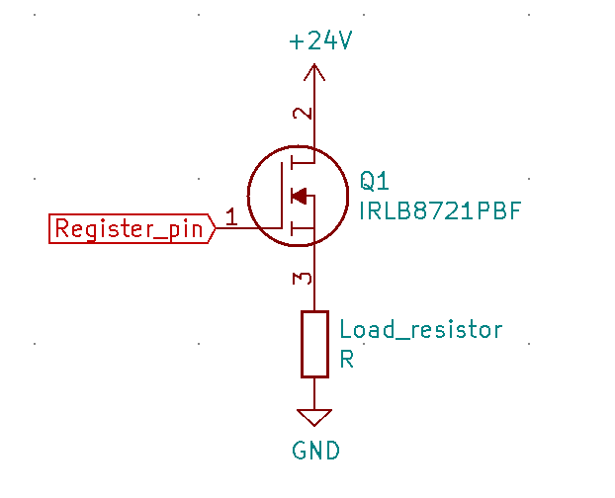
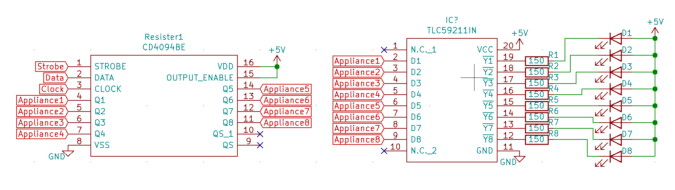
Switching
Shift Registers
MOSFET
Sink Driver
Notes:
Shift registers
The Pico switches appliances by loading values onto 8-bit shift register, using 1 register for each 8 appliances. They can be serially configured to behave as 16-bit, 24-bit, etc registers. The Pico can serially load values onto an internal register, before “strobing” to the output in parallel. This allows for values to be preloaded before a switch signal is received.
MOSFET
The registers output to MOSFETs to switch load resistors. I chose a MOSFET with a low $R_{DS\left(on\right)}$ of $6.5mΩ$, and a voltage rating greater than the 24V supply used for the load resistors.
Sink driver
As the registers cannot source enough current to drive LEDs, they also output to sink drivers. The schematic shows the connection made to LEDs, however in reality the LEDs will all be off board within a model house.

Slide 7
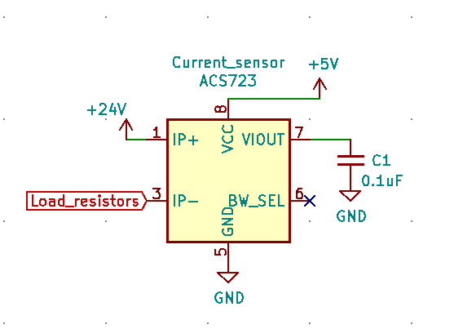
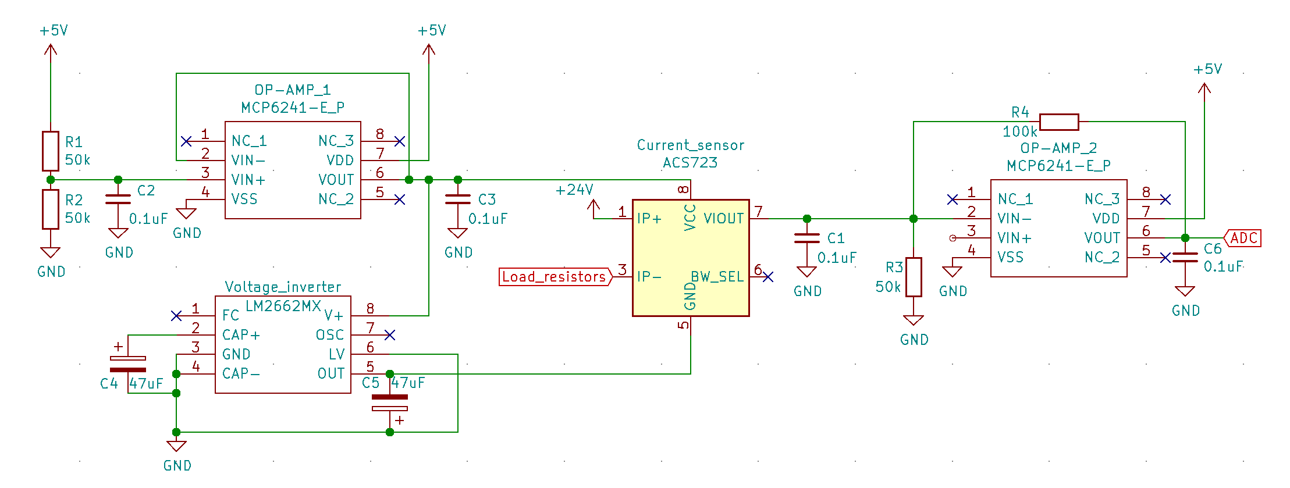
Current Detection
Sensor
Inversion and Amplification
Notes:
Sensor
The ACS721 is a bi direction current sensor that outputs 400mV/A
Testing
Testing one of these chips showed this output ratio to be accurate. Note the output of 2.5V at 0A due to being bidirectional.

Slide 8
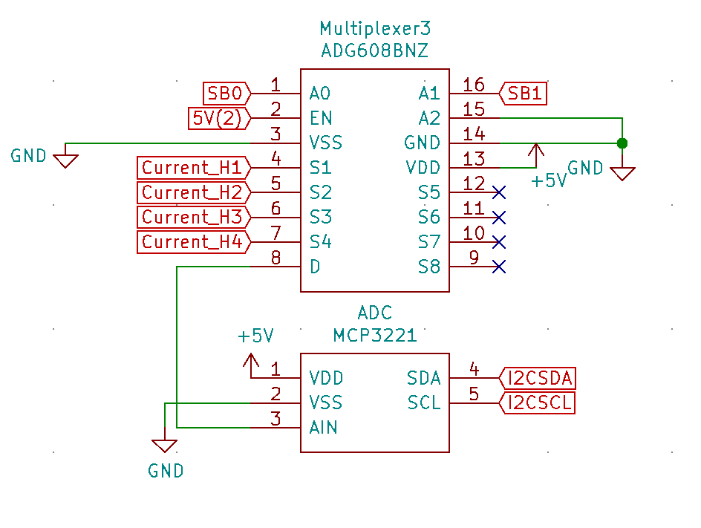
Current Detection
Multiplexing
ADC
Notes:
Multiplexing
The amplifier outputs to a multiplexer on the control board that then output to an ADC, this way current detection can be done across all 4 houses using a single ADC.
ADC
The MCP3221 ADC has 12-bit resolution, and a 22.3k sample rate.

Slide 9
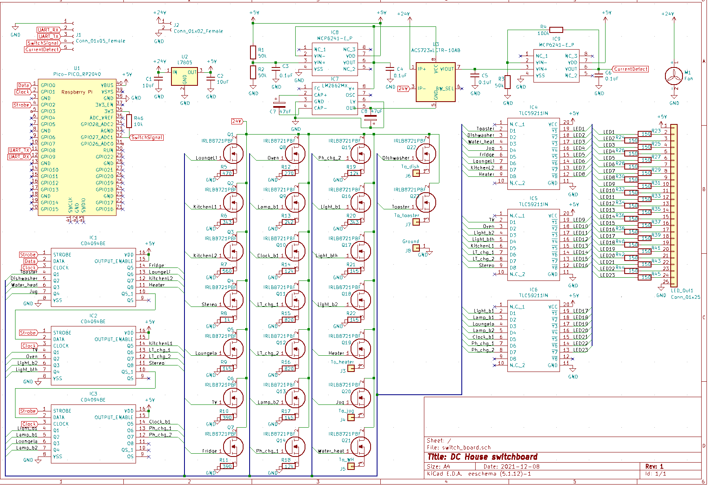
Switch Board Full Schematic
Notes:
Say what it is

Slide 10
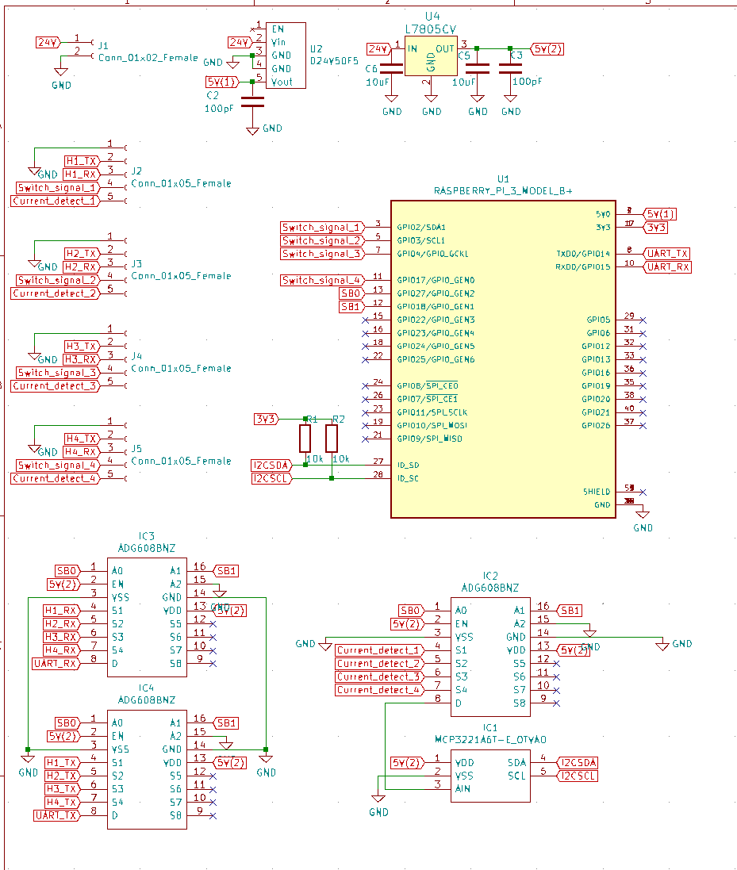
Control Board Full Schematic
Notes:
Say what it is

Slide 11
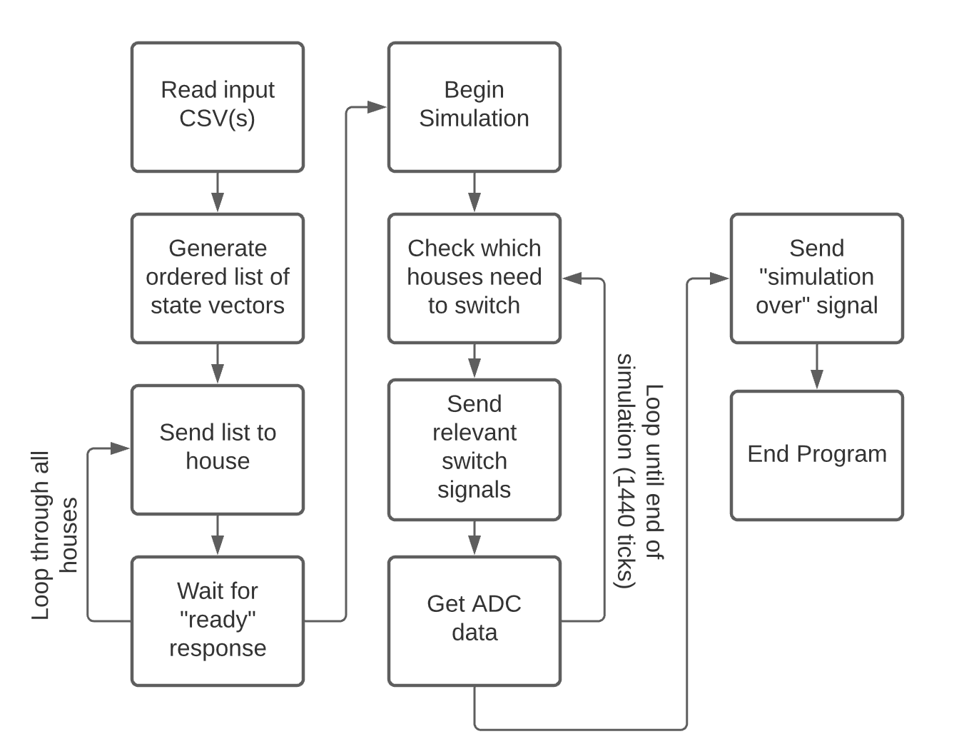
Raspberry Pi Software Process
Notes:
Quickly talk through process

Slide 12
State Vectors
01101111
11101111
11101101
AND 01111111
OR 00000010
Notes:
State vectors stored as 1 byte for each appliances
Made by performing logical operations on previous vector
*Click*
To switch this appliance
*Click*
Perform OR
*Click*
TO switch this one
*Click*
Perform AND
*Click*

Slide 13
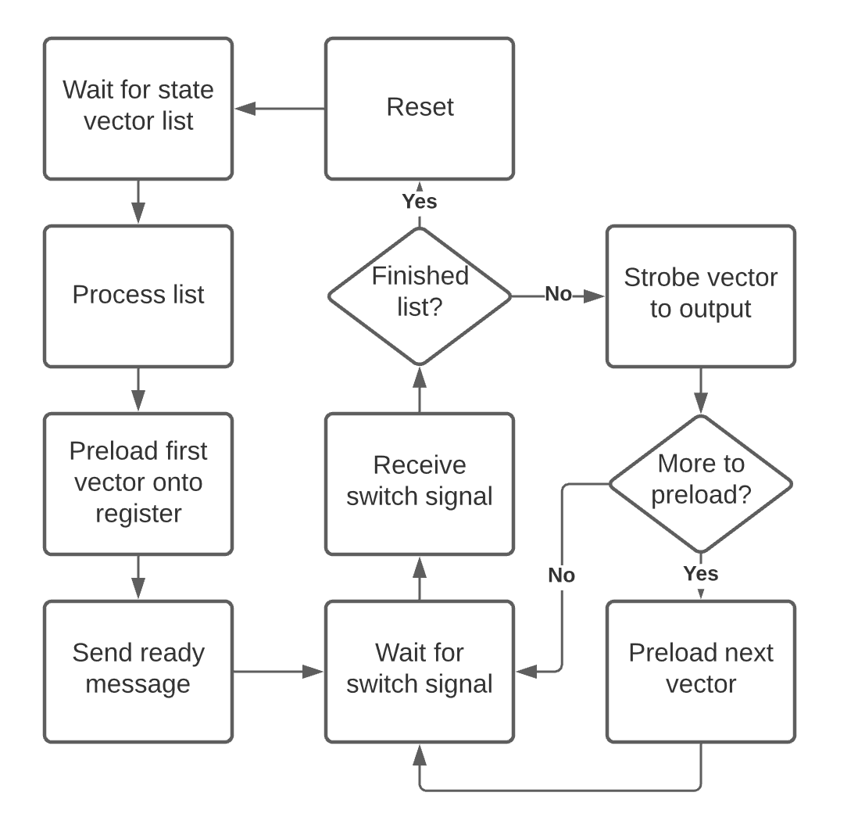
Pi Pico Software Process
Notes:
Quickly go over process

Slide 14
What do I still need to do?
01
02
03
04
Finish Writing Software
Design Enclosures for PCBs
Make Switchboard PCBs for the other 3 houses
Populate PCBs

Slide 15
What Have I Learnt?
Read Thoroughly
Component Selection
Notes:
Read documentation thoroughly to understand details of what can and can’t be done, and what should be done.
Byte at a time communication
Decide what is needed, design circuit, and select components to make this, change circuit if necessary

Slide 16
Questions?

